Slide 1
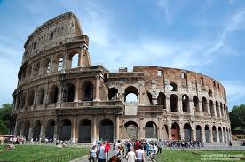
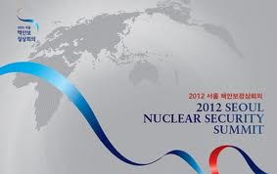
Rome Was Not Built in a Day - The Road Not Taken with Innovation and Lessons -
U C Lee, Professor
Department of Nuclear Engineering
Seoul National University

Slide 2
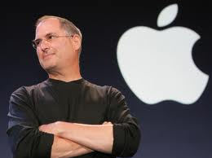
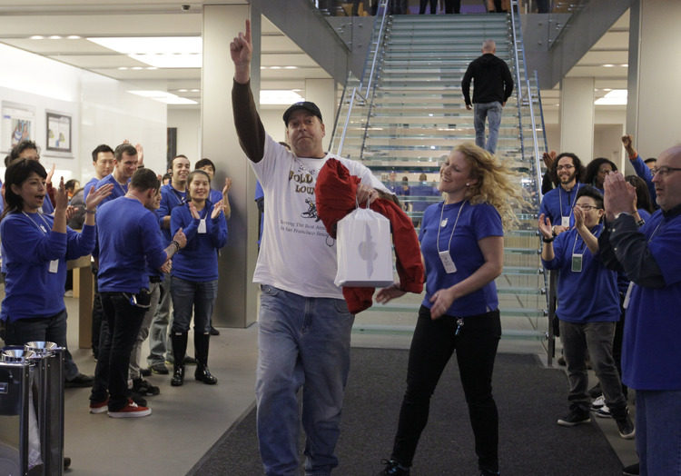
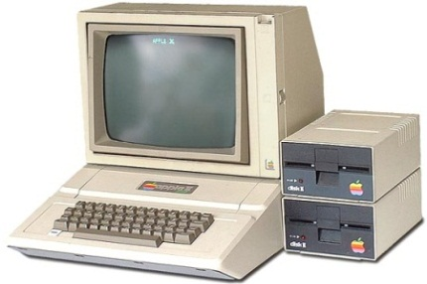
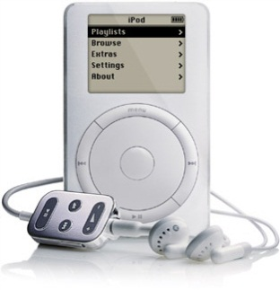
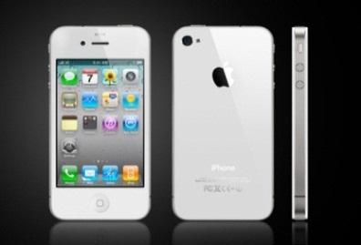
Rome, A new I-Pad, was not built in a day - Paradigm with Innovation & Lessons -
The market leader just releasing a New I-PAD with the long history of glory and rainy days.
Learn the values of creativity in association of all the lessons from the past
Notes:
Today I would like to open my talk with the story of Apple. As you know Apple started to launch a new I-PAD early this month. Many hundreds of people waited the lines over night before the apple stores around the world just to purchase a new iPAD.
Many people might recognize the Apple as a leader with innovation.
However to me the success story of the Apple explicitly demonstrates the importance of the synergy effect of the innovative minds with the vale of old lessons throughout the history. In the middle of 80’s and 90’s the Apple was almost broke. But in these rainy days the Apple learned the lessons such as importance of the simplicity and the customer first products such as iPhone and Ipod. In addition all the Apple products comes from the team effort from the international community. If you just open up the new i-PAD, you can easily find out that all the key components come from its rivals such as SAMSUNG in Korea.
The value of a paradigm with innovative ways of thinking and lessons from the history in association with the international cooperation is the key message for the entire global community including our world, the nuclear society

Slide 3
Facts and Lessons with the DPRK
The DPRK needed and still needs the sustainable supply of energy and envisages that Nuclear Energy System will be the best solution for it
KEDO Project was not fully implemented.
The DPRK has (1) man-power, (2) sensitive technologies, and (3) materials for WMDs.
Notes:
Now I would like to focus on my presentation, my proposal for the DPRK issues and the global non-proliferation. To do that I would like to go back to the past to learn lessons from our previous efforts and try to understand the current market demands.

Slide 4
Principles for the DPRK Issues - Creation of a Good Example for the policy framework & its implementation by Good Guys -
Multiple Lines of Defense by Multi-lateral cooperation
First Line of Defense: management of sensitive materials and core man-power
Second Line of Defense: management of other materials including liquid wastes and facilities along with associated workers
Additional Line of Defense: cultivating non-proliferation environment and the policy frameworks
Limiting Chances of Potential Divergence while Supplying Energy for the sustainability of the DPRK
Sustainable energy supply to the DPRK
Re-location of man-power for potential job transfer to the commercial industries
Material accountability and control with full integration of 3S, Security, Safety, and Safeguardability

Slide 5
New Paradigm with Experiences and Innovation
Supply of energy by nuclear power plant to be installed in the DPRK
Supply of fresh fuel and take back of used nuclear fuel by international framework
significant contribution from the ROK
Assurance of supply by the global partners such as IAEA fuel bank
Proper management of man-power, technologies, and materials
New framework development for non-proliferation and the atoms for peace

Slide 6
Supply of Energy by Nuclear Power Plants
The DPRK needed and still needs a sustainable energy resource in her territory
The KEDO Project was established to meet that goal
The global society needs a certain measure to meet the energy demand of the DPRK to back up the successful six party talks
The installation of NPP’s has been preferred by DPRK
The new installation of NPPS will be a pragmatic approach with encouragement of the pros of the old abandoned project but strong limitation against key cons

Slide 7
Fuel Cycle Service under the International Framework
No more UEP and reprocessing: minimizing the residence time of the fresh & used nuclear fuel in the DPRK
Defense in Depth for Assurance of Supply(AoS) of fresh fuel
Front line supplier: ROK?
Backup suppliers: PRC, Japan, and RF?
Emergency supplier: IAEA fuel bank
Used Fuel Take-back by suppliers
The ROK can act as a prime server for this task
Economy: Less burden of transportation cost
Public support for the nuclear energy system benefiting the entire Korean Peninsular

Slide 8
Management of Man-power, Technologies, and Materials
Principles
Minimization of the spread of sensitive technologies, materials, and man-power
Understanding the experiences from the history
Old Soviet Case: Good collaboration between the US and the old SU countries
Middle East: Cultural barriers between the US and the states like Iraq
The well prepared, timely, and sincere involvement of the ROK is a must
Man-power & Technologies: Classification of the DPRK work-forces
Core scientists with full accessibility to the nuclear weapon programs: Role of the US, PRC, and RF to prevent the chance of potential divergence of sensitive information
Scientists with limited experiences: Active collaboration of the ROK and the US for re-education and re-location of these members
Other staffs and associated family members: Contribution from the ROK
Materials
Sensitive materials & facilities: Full control by P-5 members in the six party talk in association with the international watch dog IAEA
Decommissioning, dismantling, and environmental restoration of other DPRK facilities: Primary role of the ROK
Treatment of liquid wastes: Team approach of the US and the ROK with well experienced states and the IAEA for material accountability and solidification

Slide 9
Better World for Non-proliferation and Atoms for Peace - A Good Beginning is Half Done -
The ROK Contribution for Non-proliferation
Policy Making Study
The ROK is very unique in the world nuclear community
Non Nuclear Weapon State but the Global Leader in Atoms for Peace
New active member for the international nuclear market
Willing to serve as a prime contributor for the new policy framework development on the promotion of nuclear non-proliferation while supporting the peaceful application of nuclear energy
Technical Support
Time for a new paradigm and cooperation
The existing approaches such as the Gold Standard Approach(or the Universal Compliance Approach) and the Case by Case approach are not fully applicable yet
We need a good working example demonstrating the benefit of the international engagement
Multi-lateral Approach for the DPRK issues can serve as a good starting point
How to supply the sustainable energy
How to create the international framework to discourage the EnR(Enrichment and Reprocessing) in the DPRK
How to set up the overall and the detailed plan for the DPRK experts
How to set-up the framework for the nuclear fuel cycle services:
The ROK will act as a new global leader for the development of a new paradigm and its full implementation

Slide 10
Summary & The Way Forward
We need sincere effort to solve the DPRK issues: 6W
Why, What, When?: rather clear
Who can do this work to the end?
Where to store & deposit the waste?
Framework development for site securing and implementation approaches
Options: D&D and others
How?
Domestic efforts in the ROK
International framework development
Work period
Financial arrangement: contribution of expenses from the international societies and etc
Man-power arrangement
Sincere and timely actions for the development of the collaboration programs in the ROK & among the international societies

Slide 11
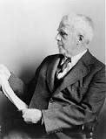
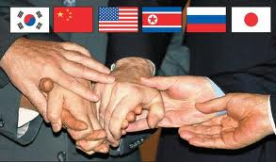
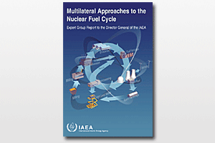
Conclusions - The Road Not Taken -
Two roads diverged in a yellow wood, And sorry I could not travel both And be one traveler, long I stood And looked down one as far as I could To where it bent in the undergrowth; Then took the other, as just as fair, And having perhaps the better claim Because it was grassy and wanted wear; Though as for that the passing there Had worn them really about the same, And both that morning equally lay In leaves no step had trodden black. Oh, I kept the first for another day! Yet knowing how way leads on to way, I doubted if I should ever come back. I shall be telling this with a sigh Somewhere ages and ages hence: Two roads diverged in a wood, and I— I took the one less traveled by, And that has made all the difference

Slide 12
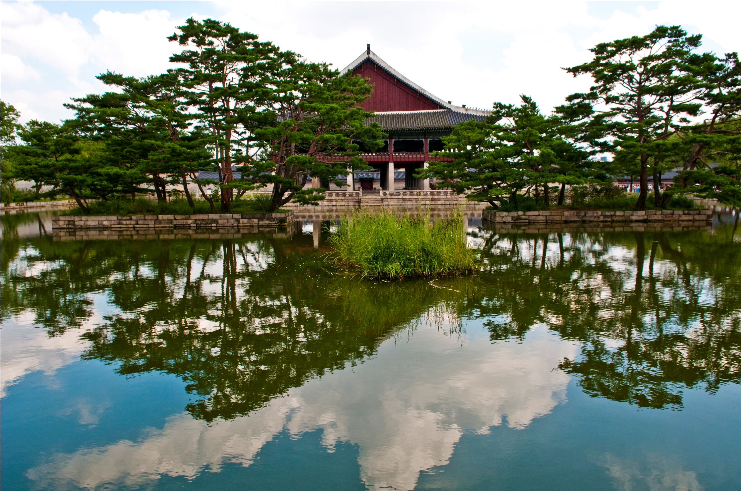
Thank You for Your Attention !

